Slide 1


Heart Stroke Prediction Analysis
Insights and Preventive Analytics using Power BI
BY: Ramnath Bhat

Slide 2

Introduction
Overview:
Stroke is a critical health issue, leading to severe disability and mortality.
Preventive care requires early identification of high-risk individuals.
Objective:
Predict stroke likelihood using demographic and health factors.
Use Power BI for interactive visualizations.
Support healthcare strategies to reduce stroke cases.

Slide 3

Problem Statement & Data Overview
Problem Statement:
Identifying high-risk individuals in time.
Making data-driven interventions accessible for healthcare providers.
Data Overview:
Sources: Hospital records, public datasets, research.
Key Variables: Age, gender, BMI, blood pressure, glucose, lifestyle, stroke occurrence

Slide 4
Methodology
Steps:
Data cleaning (handle missing values and outliers).
Feature engineering and normalization.
Balance data using SMOTE for class imbalance.
Tools:
Python for data processing and model building.
Power BI for visualization and dashboard creation.

Slide 5
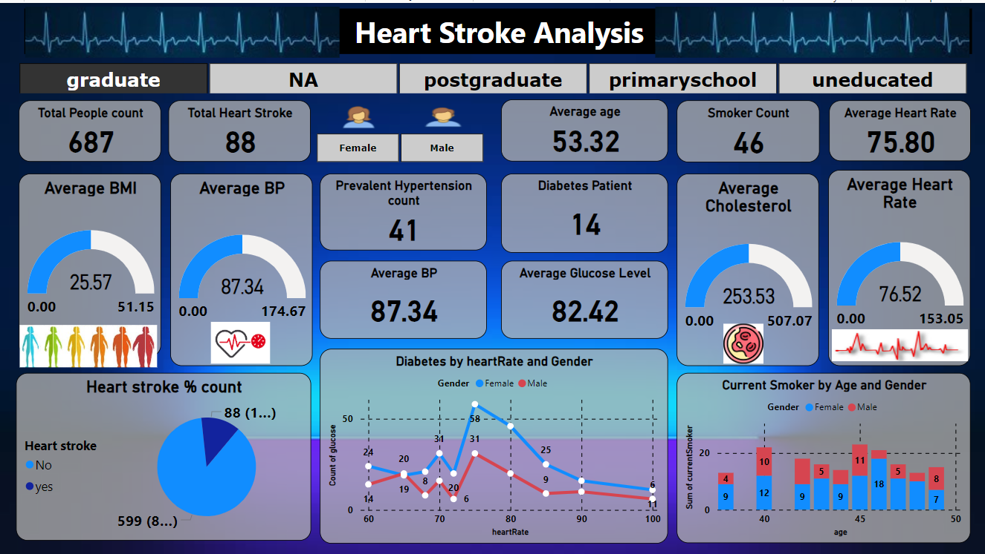
Power BI Dashboard Overview

Slide 6
Insights from the Dashboard
Key Findings:
Hypertension and diabetes significantly contribute to stroke risks.
Smokers and individuals with higher cholesterol levels are at greater risk.
Average metrics:
Age: 53.32 years
BMI: 25.57
BP: 87.34
Glucose: 82.42

Slide 7


Predictive Model & Recommendations
Predictive Model:
Recommendations:
Tools: Random Forest, XGBoost for stroke risk prediction.
Results: Enables targeted healthcare interventions.
Promote lifestyle changes (quit smoking, manage diabetes).
Early screening for high-risk groups, especially individuals above 50.
Awareness campaigns tailored to education levels.

Slide 8

Conclusion
Conclusion:
Actionable insights from Power BI dashboards.
Predictive analytics empower healthcare decisions.
Preventive strategies can significantly reduce stroke incidence.
Next Steps:
Integrate more data sources and real-time analytics.

